Slide 1

Rusterizer Masterclass Going 3d
Luca Quartesan – quartesan.l@buas.nl – 03-10/02/2021

Slide 2
Welcome v0.2
Features that we are not going to implement are marked with 🚩
🚩are left behind so you can expand on what we see during the lectures

Slide 3
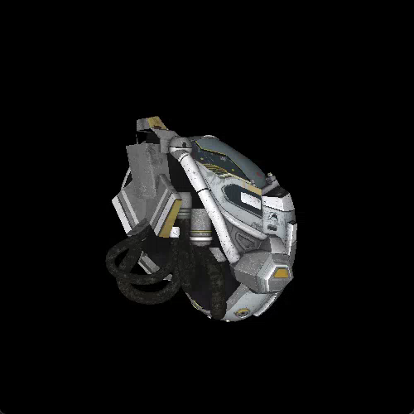
Agenda
Last Episode
Moving our camera
Clipping and culling
Taking normal into account
Simple shading

Slide 4
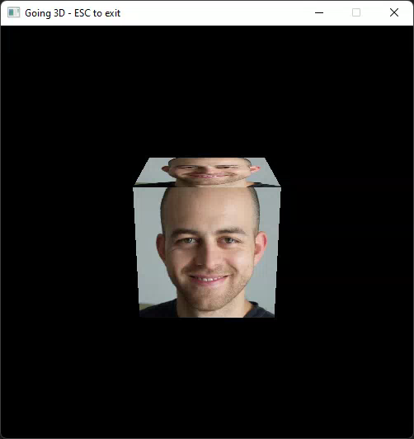
Last Episode
3D Transformations = Matrices * Vectors
Concatenating transformations
Perspective correction to interpolate while taking depth into account

Slide 5
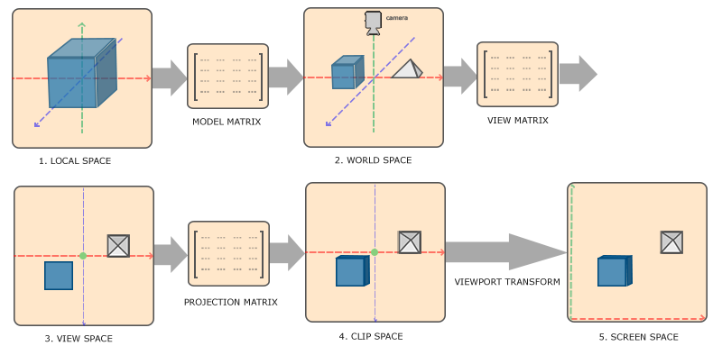
Coordinate Systems
https://learnopengl.com/Getting-started/Coordinate-Systems

Slide 6
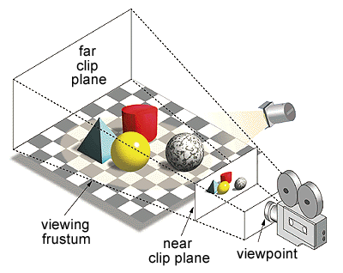
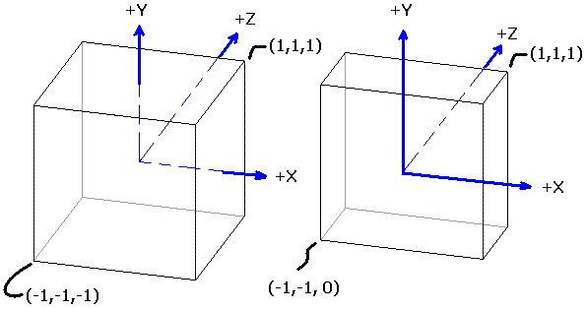
Projection Matrix
The goal is to map view volume to a unit cube
Either:
Orthographic: rectangular parallelepiped
Perspective: Frustum
https://gdbooks.gitbooks.io/3dcollisions/content/Chapter6/frustum.html

Slide 7
Perspective correction
When we interpolate our parameter
we divide-first-then-interpolate➡️, since we are past NDC (we divided by w)
projection ➡️ Interpolation
what would have been the parameter β if we had interpolate-first-then-divide ⬅️
Interpolation ➡️ projection
We want to interpolate in 3D

Slide 8
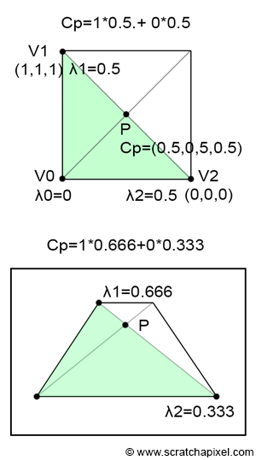
Perspective correction
We need to take also the difference in depth (view z = clip w)
Divide attributes by their z (reciprocals = 1/z)
Then interpolate the attributes and reciprocals
Multiply attribute by 1/interpolated reciprocal

Slide 9
Perspective correction
Divide attributes by their z (reciprocals)
Then interpolate the attributes and z
Multiply attribute by interpolated z
https://www.scratchapixel.com/lessons/3d-basic-rendering/rasterization-practical-implementation/perspective-correct-interpolation-vertex-attributes

Slide 10
Moving
Have you tried moving?
Did something weird happen when objects went off screen or too close to the camera?

Slide 11
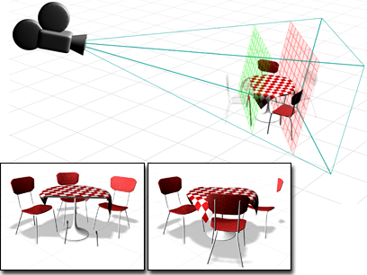
Clipping
vertices may have been projected behind the eye
Clipping consists in “cutting” ✂️ a triangle along a plane
Two methods:
Raster clipping
Geometric clipping

Slide 12
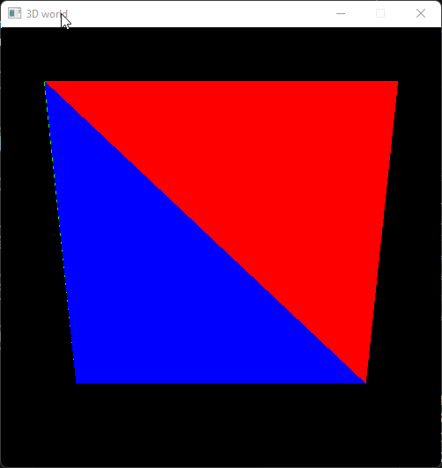
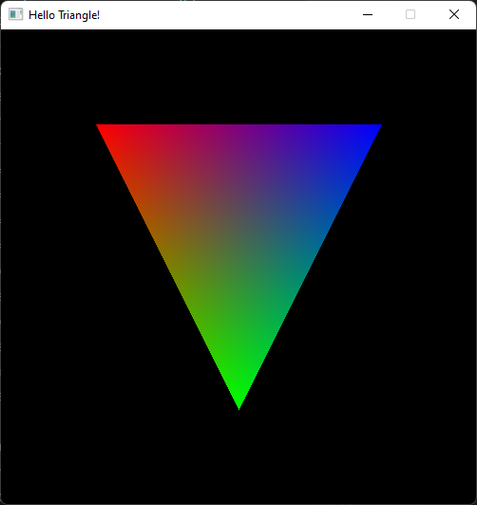
Clipping

Slide 13
Raster clipping
We clip against the viewport edges
We just address this from 2D
Simply we never check for pixels outside the viewport
Pretty simple!

Slide 14
Raster clipping
In NDC space
Discard pixels outside viewport
Calculations don’t change
a bounding box around the triangle that determines the pixels we are going to render
Now our rasterizer will go muuuch faster

Slide 15
Geometric clipping
This can be done either in view or clip space
Let’s do it in clip space
Consists in cutting our triangle by a plane
We need to check against all six planes:
But in clip space is simple: unit cube
All values between –w and w in all 3 dimensions are inside our volume

Slide 16
Geometric clipping - culling
If a coordinate(e.g. x) of all 3 vertices is >|w|
Then we need to “cull” -> discard our triangle
If at least one vertex is inside the volume we need to clip
🚩Clipping against all planes is complicated and on the x and y axis we are already clipping thanks to the raster clipping
We can focus on near and far

Slide 17
Geometric clipping
To make our lives even easier let’s only clip against the near clip plane
For the far we will just implement culling
Now we are in the simplest example: clipping against a single plane
Which we can reduce to a simple 2D problem

Slide 18
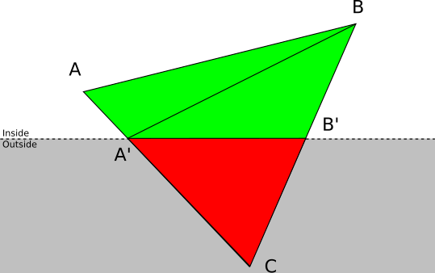
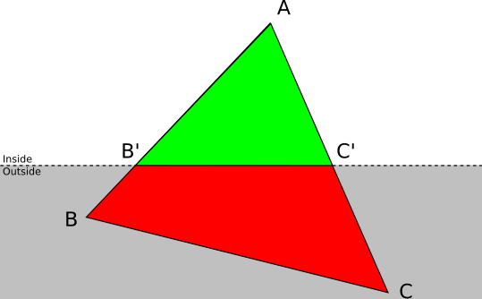
Geometric clipping
Check for z: if < 0
Two cases:
https://gabrielgambetta.com/computer-graphics-from-scratch/11-clipping.html

Slide 19
Geometric clipping
Two vertices outside (A, C)
α = AB’/AB
β = AC’/AC
B’=Lerp (A,B, α )
C’=Lerp (A,C, β)
https://gabrielgambetta.com/computer-graphics-from-scratch/11-clipping.html

Slide 20
Geometric clipping
One vertex outside(C)
α = AC’/AC
β = BC’/BC
A’=Lerp (A,C, α )
B’=Lerp (B,C, β)
Return: (A,A’,B) and (A’,B,B’)
https://gabrielgambetta.com/computer-graphics-from-scratch/11-clipping.html

Slide 21
Geometric clipping
Finally interpolate all vertex attributes for the clipped triangles
🚩Other solutions:
Sutherland–Hodgman algorithm
Segment-plane intersection

Slide 22
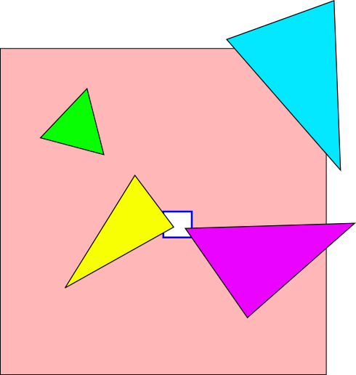
Guard Band clipping
Another type of clipping
Where we don’t really clip
Extend our clipping volume (x,y) up to a certain threshold
Raster clipping done afterwardss
https://fgiesen.wordpress.com/2011/07/09/a-trip-through-the-graphics-pipeline-2011-index/

Slide 23
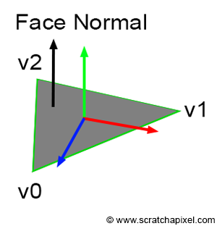
Backface culling
Optimization strategy
All triangles not facing the camera are discarded
Inner part of the object is culled
Calculated with cross product = direction of the normal
If it is negative in clip space then it is facing the camera

Slide 24

Loading Gltf

Slide 25
Shading
Let’s take normal into account
We could interpolate them as any other value
But there is more…
They are defined in local space:
We need to transform them
https://www.scratchapixel.com/lessons/3d-basic-rendering/introduction-to-shading/shading-normals

Slide 26
Shading – Normals
Usually this is achieved by transforming our normal by the Transpose Inverse of the model Matrix
This is derived by the dot product (but can face two directions!) ❌
A more correct approach is using the matrix of cofactors of the model matrix
Derived by cross product (our normal) ✅
https://github.com/graphitemaster/normals_revisited

Slide 27
Shading💡
Now we can calculate Normal dot Light direction
And multiply this by our output color
Let’s also add a small amount of ambient light ☺
https://github.com/graphitemaster/normals_revisited

Slide 28
Thank you! 🦀
Many questions?

Slide 29
You could try
Clipping against all planes
Normal mapping (requires tangent space🚀)
But for today GLTF loading and clipping might be plenty ☺

Slide 30
Resources
Rasterization: a Practical Implementation
Optimizing Software Occlusion Culling – index | The ryg blog
Texture Mapping & Polygon Rasterizing Tutorial (1/2) [C++20] – YouTube
3D Programming Fundamentals [Introduction] Tutorial 0 – YouTube
Rasterizer Algorithm Explanation – YouTube

